Slide 1
The CARE Fund:
A Philanthropic Initiative to Meet the Moment
Housekeeping Tips
Introduce yourself in the Chat box
All attendees are participating in Listen Only mode
Post your questions in the Q&A box
Webinar is being recorded and will be made available
All resources linked in the chat box will be shared in a follow-up email
Share your “bright spots and silver linings” and “keepers” in the Chat box
and on social media: #GLRKeepers

Slide 2
GLRWeek2021.gradelevelreading.net / #GLRKeepers

Slide 3
Plenary Sessions
A Virtual Gratitude Reception: CGLR Salutes Our Partners
Monday, July 26, 2021, 3–4:30 p.m. ET
Meeting the Moment: Accelerating Equitable Recovery and Transformative Change
Tuesday, July 27, 3–4 p.m. ET
Co-sponsored by Education Week and hosted on the On24 platform
Bringing Digital Equity Home: The Suncoast Digital Access for All Initiative
Wednesday, July 28, 3–4:30 p.m. ET – A Crucible of Practice Salon
The CARE Fund: A Philanthropic Initiative to Meet the Moment
Co-Sponsored by United Philanthropy Forum
Thursday, July 29, 3–4:30 p.m. ET – A Funder-to-Funder Conversation
Assume Collaboration: A Consultative Conversation on Aggregating for Impact
Friday, July 30, 2:30–4 p.m. ET (invitation only)

Slide 4
GLRWeek2021.gradelevelreading.net
Share in the Chat and connect with @Readingby3rd onTwitter and #CampaignforGLR on Facebook
to share #GLRKeepers!

Slide 5
The Care Fund
A Philanthropic Initiative to Meet the Moment
A Funder-to-Funder Conversation
Co-Sponsored by United Philanthropy Forum
Thursday, July 29, 3–4:30 PM ET
GLRWeek2021.gradelevelreading.net / #GLRKeepers

Slide 6
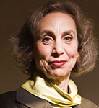
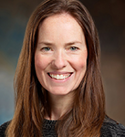
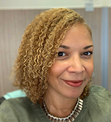
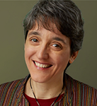
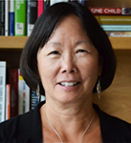
Presenter
Erin Currier
Program Officer
Family Economic Security
W.K. Kellogg Foundation
Moderator
Melissa A. Berman, Ph.D.
President & CEO
Rockefeller Philanthropy Advisors
Introductions
Traci Slater-Rigaud
Director of Member Engagement
& Partnerships
United Philanthropy Forum
Presenter
Anna Wadia
Senior Program Officer
Future of Work(ers)
Ford Foundation
Presenter
Barbara Chow
Education Program Director
Heising-Simons Foundation
6

Slide 7
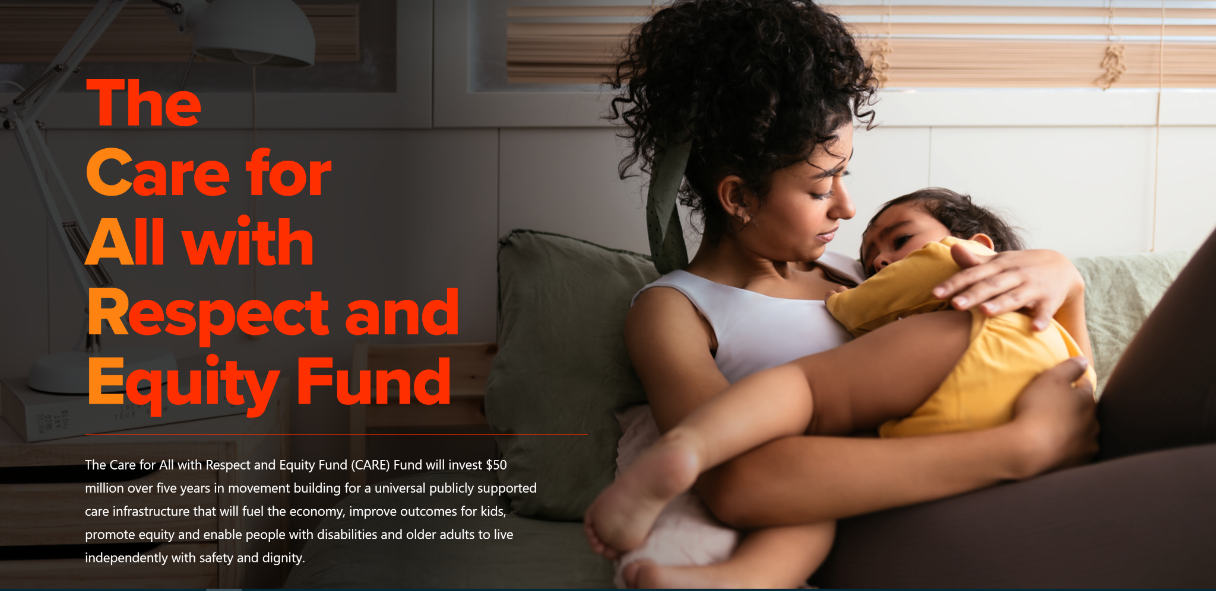

Slide 8
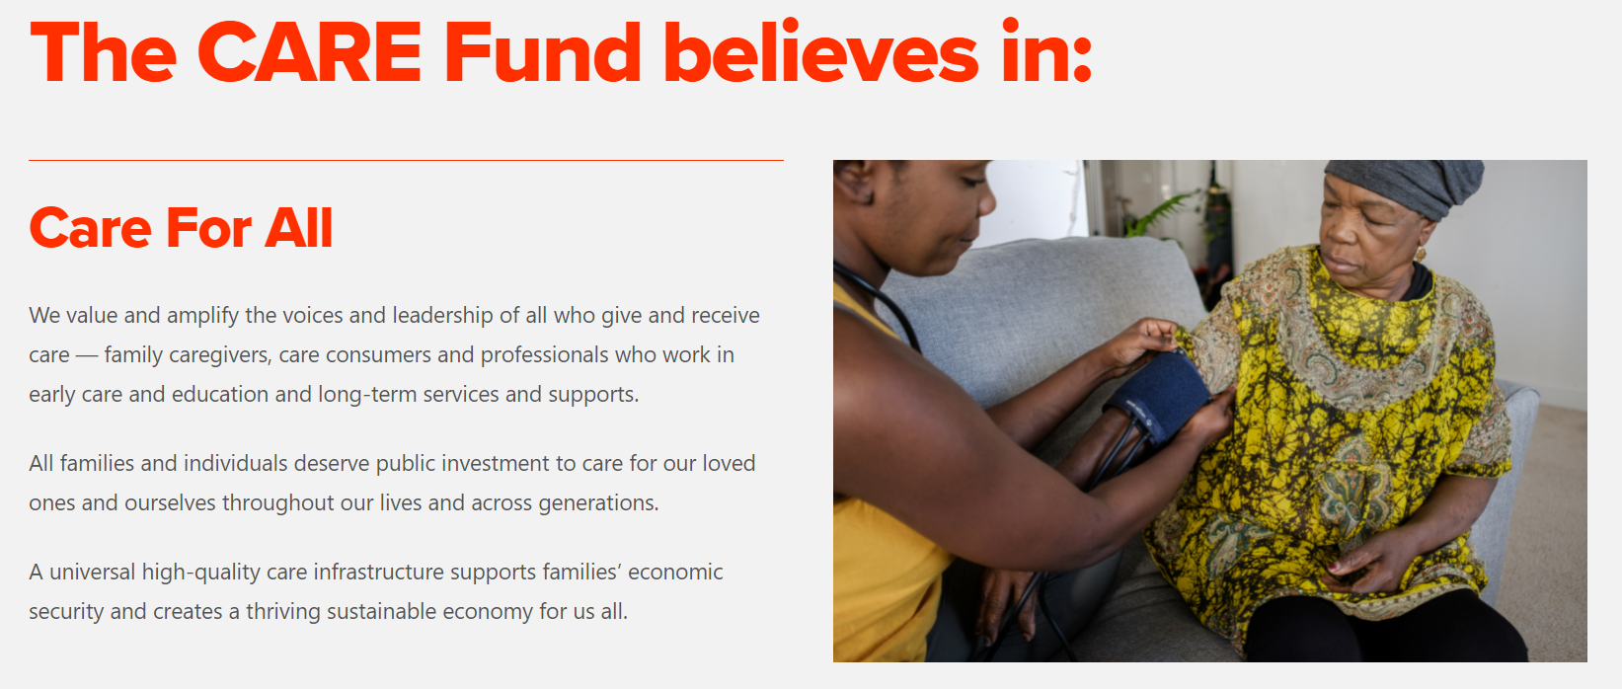
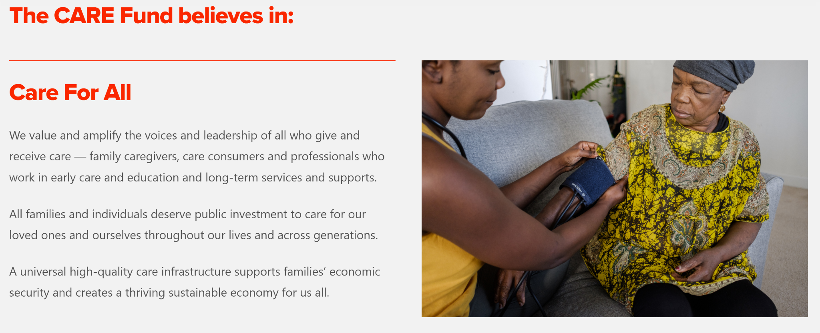
Notes:
Snipped and pasted from website

Slide 9
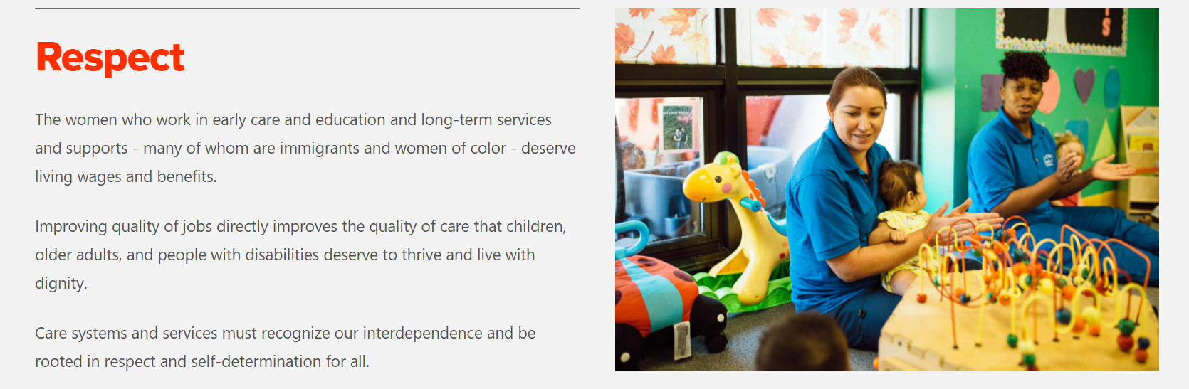
Notes:
Snipped and pasted from website

Slide 10
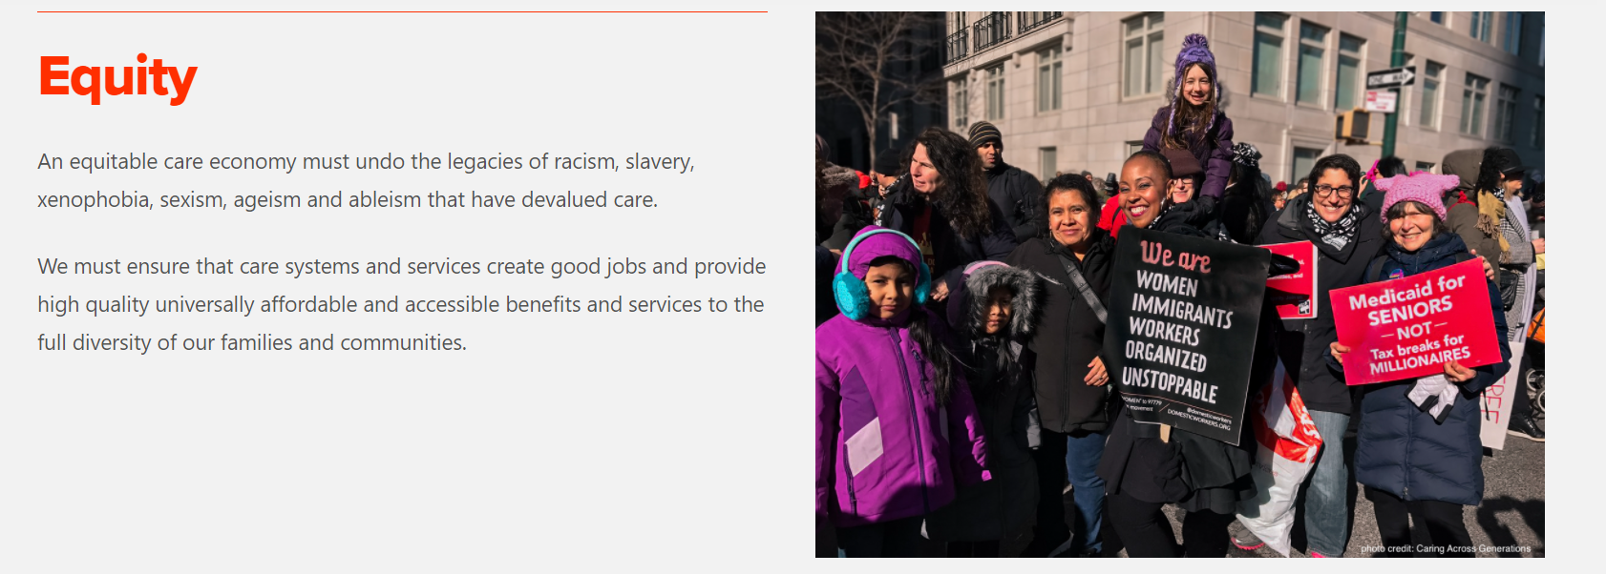
Notes:
Snipped and pasted from website

Slide 11
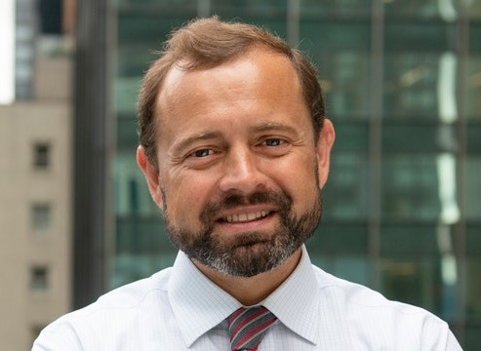
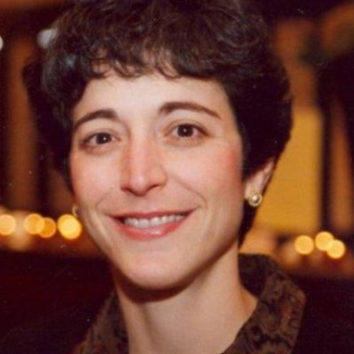
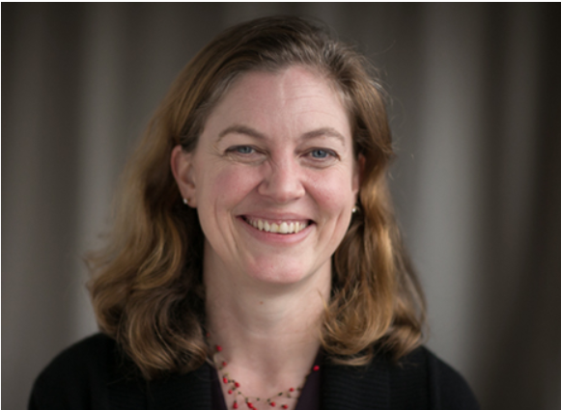
Why the CARE Fund?
“We must care for the essential workers who care for our children and people who are sick and aging. The CARE Fund and #CareCan’tWait are designed to make sure we address our nation’s pre-existing conditions and build a care economy that guarantees paid leave, childcare and long-term care for all.”
“We need policies rooted in racial, gender, and economic justice that protect what is essential: the time to bond after a baby is born, the ability of a parent to earn a living, and the well-being of the professionals who care for our babies and elders when we cannot.”
“Women — particularly Black women and other women of color — and low-wage workers of all races bear the burden of an economy that unfairly advances some at the expense of too many. The CARE Fund will push forward a vision of care work as deserving of greater recognition and financial support from businesses and our government.”
Thomas Perriello, Executive Director, Open Society-U.S.
Stacy Schusterman, Chair, Schusterman Family Philanthropies
Becca Graves, Executive Director, Perigee Fund
Notes:
Add Erin's slide on funders

Slide 12
Rapid Response Docket
Coordinating Tables
Grassroots Leadership
Aging and Disability Rights
Coordinating tables that are the forefront of collaborative policy advocacy efforts, with a focus on universal paid leave, quality care jobs, and robust financing for both long term services and supports and early care and education.
Grassroots leadership and movement building efforts that ensure the diverse voices and expertise of parent leaders, family caregivers, and care workers are at the center of narrative change and federal policy reforms.
Organizations bringing an aging and disability rights lens to care policy – especially home and community based care and paid leave – and integrating racial, ethnic, LGBTQ and gender justice.
Care Can’t Wait
Childcare for Every Family Network
Paid Leave for All
Family Values at Work
Caring Across Generations
MomsRising Education Fund
National Domestic Workers Alliance
United Parent Leaders Action Network
American Association of People with Disabilities
Diverse Elders Coalition
Justice in Aging
The Arc
UsAgainstAlzheimer’s

Slide 13
Grantees Working at the Intersections
Child Care & Early Education Programs & Workforce
Long-term Services & Support & Workforce
National Domestic Workers Alliance
Child care for Every Family Network
United Parent Leadership Action Network (UPLAN)
Justice in Aging
Diverse Elders Coalition
Care Can't Wait
Caring Across Generations
MomsRising
AAPD
Family Values at Work
US Against Alzheimer's
The Arc
Paid Leave
Paid Leave for All

Slide 14
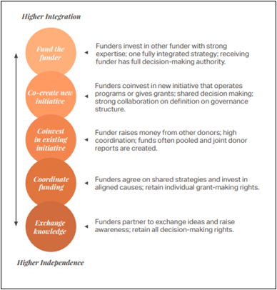
Collaborative Giving Resources
As the landscape of philanthropy continues to expand and evolve, it’s become more and more clear that the future of systemic change requires not only larger pools of funding, but more combined willpower and expertise.
Resources:
Philanthropy Roadmap Guide: Collaborative Giving
Scaling Solutions towards Shifting Systems

Slide 15

Questions & Discussion

Slide 16
State Events
Visit our new conference site to find out how dozens of states and communities confronted by COVID-19 stepped up to meet the moment.
http://glrweek2021.gradelevelreading.net/state-events/

Slide 17
Plenary Sessions
A Virtual Gratitude Reception: CGLR Salutes Our Partners
Monday, July 26, 2021, 3–4:30 p.m. ET
Meeting the Moment: Accelerating Equitable Recovery and Transformative Change
Tuesday, July 27, 3–4 p.m. ET
Co-sponsored by Education Week and hosted on the On24 platform
Bringing Digital Equity Home: The Suncoast Digital Access for All Initiative
Wednesday, July 28, 3–4:30 p.m. ET – A Crucible of Practice Salon
The CARE Fund: A Philanthropic Initiative to Meet the Moment
Co-Sponsored by United Philanthropy Forum
Thursday, July 29, 3–4:30 p.m. ET – A Funder-to-Funder Conversation
Assume Collaboration: A Consultative Conversation on Aggregating for Impact
Friday, July 30, 2:30–4 p.m. ET (invitation only)

Slide 18


@readingby3rd
@CampaignforGLR
#GLRKeepers
GLRWeek2021.gradelevelreading.net

