Slide 1
Learning to Read: Applying Universal Design for Learning Co-Sponsored by The Emily Hall Tremaine Foundation
February 7, 2023
gradelevelreading.net @readingby3rd #GLReading #LearningTuesdays #BrightSpotsSilverLinings

Slide 2
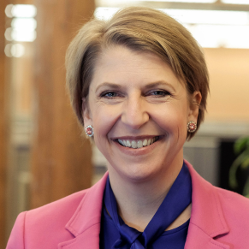
Moderator
Lindsay Jones
Chief Executive Officer
CAST
gradelevelreading.net / @readingby3rd / #GLReading
gradelevelreading.net @readingby3rd #GLReading #LearningTuesdays

Slide 3
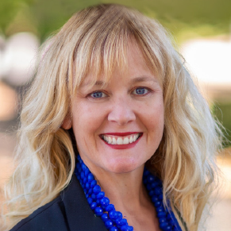
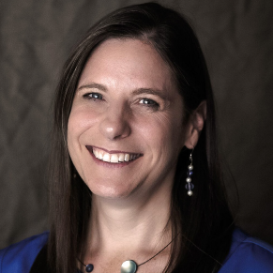
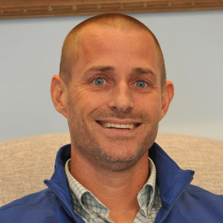
Panelists
Becky Canham
Implementation Specialist
California Coalition for Inclusive Literacy
CAST
Jennifer Levine
Chief Academic Officer PreK-12
CAST
Benjamin N. Powers DBA
Director, Global Literacy Hub
Yale Child Study Center
Yale University
gradelevelreading.net / @readingby3rd / #GLReading

Slide 4
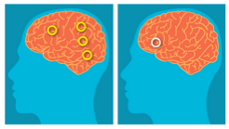
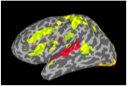
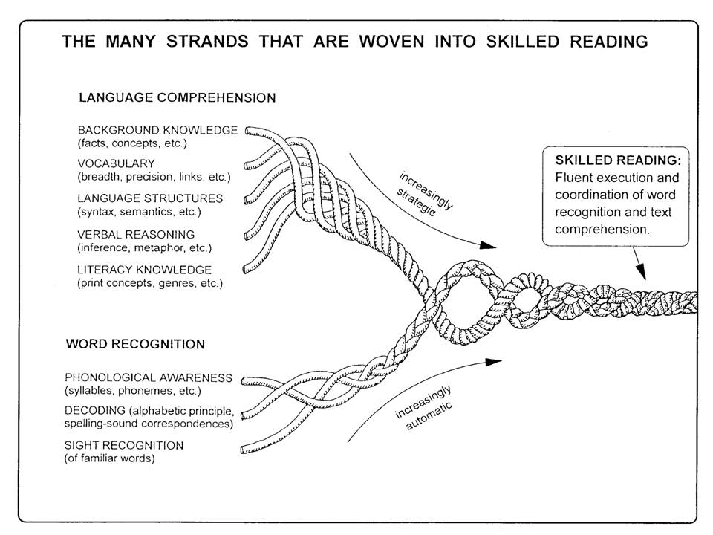
Phonological Deficit as
Central to Dyslexia
(e.g., Liberman et al.,1974)
Brain Bases of Speech & Reading Disorders
(c.f., Pugh et al., 2000; 2014)
Jointly affiliated with Yale & UCONN
Community of international scholars
Global epicenter for research on spoken and written language
Genuine inter-disciplinary approach to solving challenging research puzzles across domains
Embrace new technologies to solve old problems
Reading Rope
(Scarborough, 2001)

Slide 5
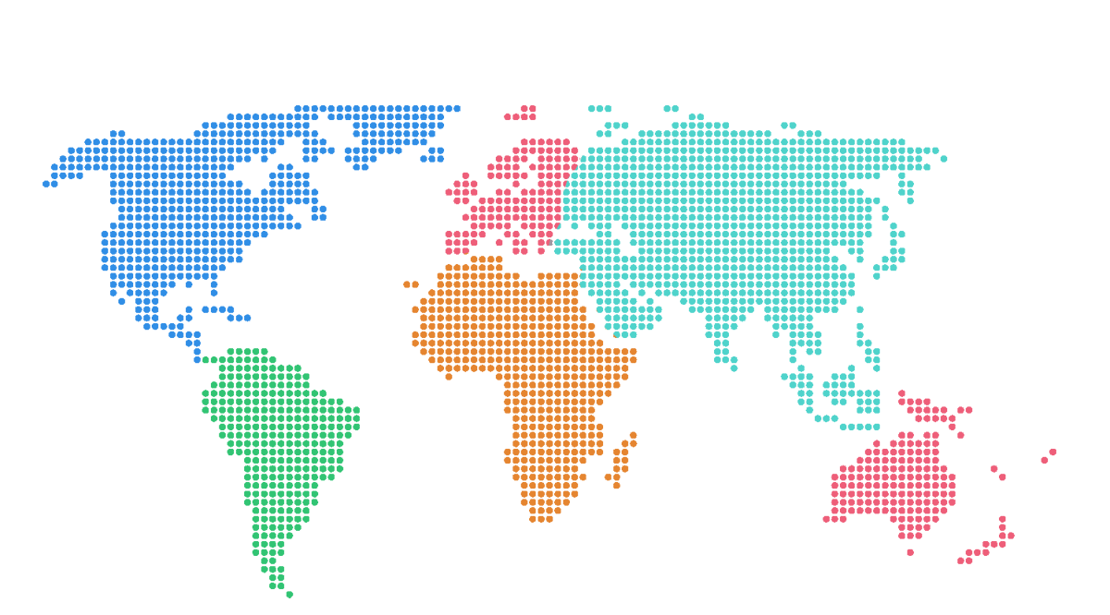
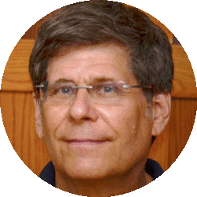
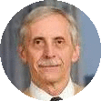
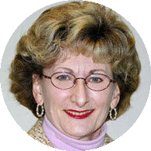
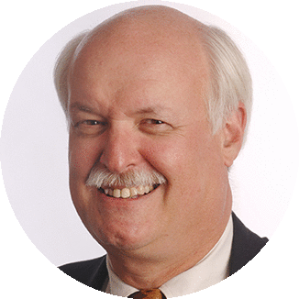
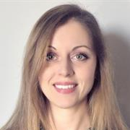
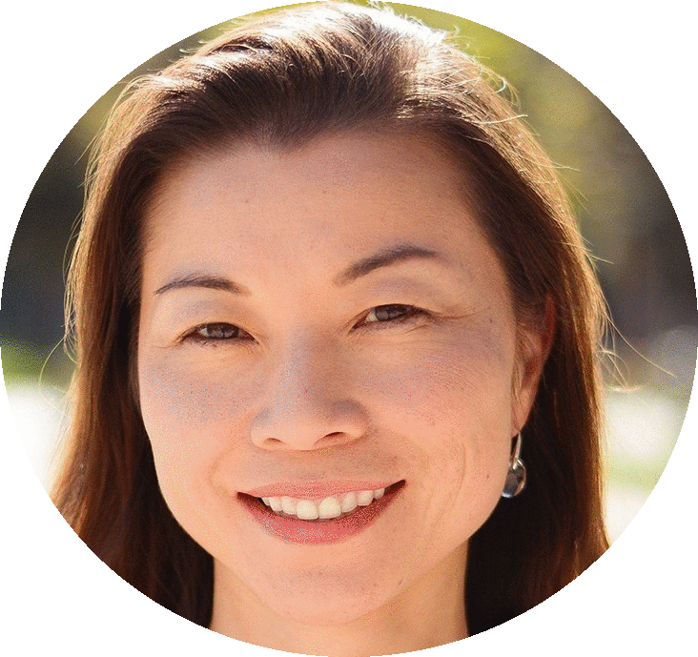
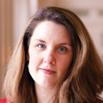
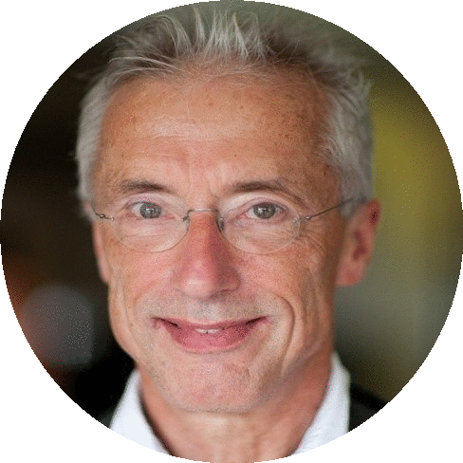
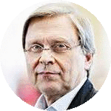
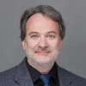
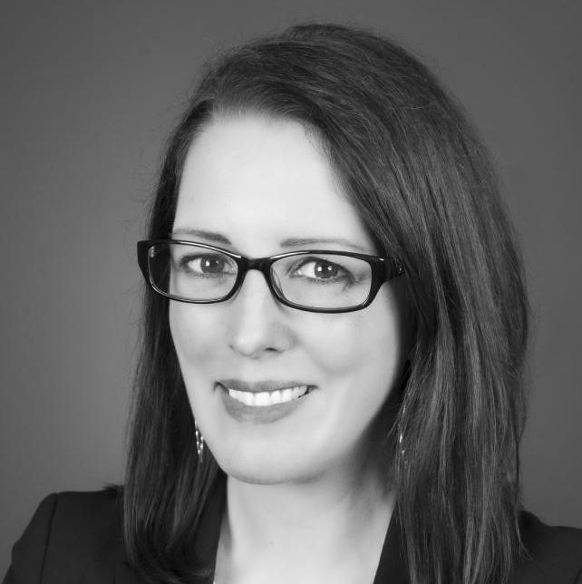
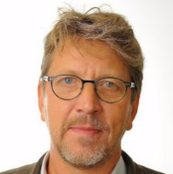
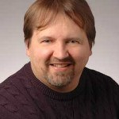
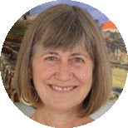
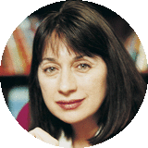
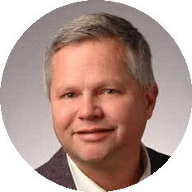
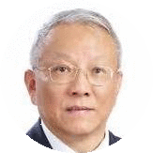
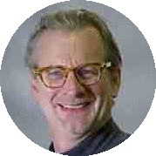
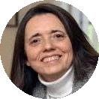
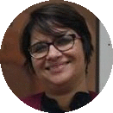
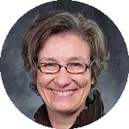
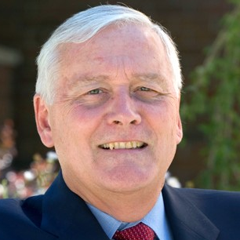
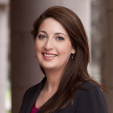
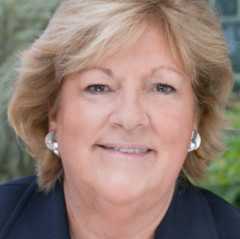
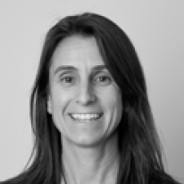
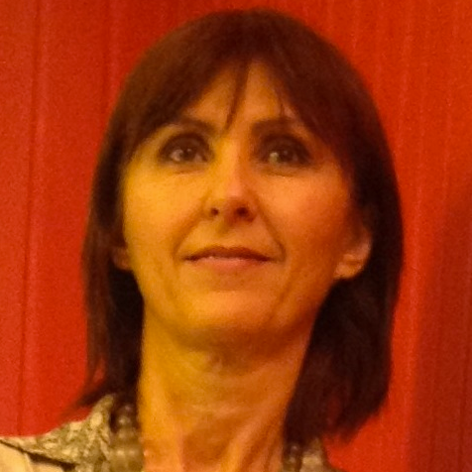
Mark Seidenberg
UW-Madison/Haskins, USA
Charles Perfetti
U Pitt LDRC, USA
Maureen Lovett
Hospital for Sick Children, Canada
Global Literacy Hub
Robin Morris
Georgia State U, USA
Kaja Jasinska
UToronto, Canada
Fumiko Hoeft
UCSF/UCONN, USA
Laurie Cutting
Vanderbilt University, USA
Devin Kearns
UCONN/Haskins, USA
Ludo Verhoven
Nat’l Lit Ed Center, Netherlands
Heikki Lyytinen
University of Jyväskylä, Finland
John Sabatini
UMemphis, USA
Nicole Landi
UCONN/Haskins, USA
Pekka Räsänen
University of Jyväskylä, Finland
Richard Aslin
Haskins/Yale/Uconn, USA
Jay Rueckl UCONN/Haskins, USA
Ulla Richardson
University of Jyväskylä, Finland
Susan Brady
Haskins/URI, USA
Maryanne Wolf
UCLA, USA
Kenneth Pugh
Haskins/Yale/Uconn, USA
Ovid Tzeng
Univ System of Taiwan/Haskins, Tawain
Don Compton
FSU FCRR, USA
Bernardo Aguilar Montie
Universidad de Monterrey, Mexico
Infancy
Linda Mayes
Yale, USA
Ben Powers
Haskins/Yale, USA
Nandini Chatterjee Singh
Nat’l Brain Res Cnter, India
Elena Grigorenko
U of Houston; BCM, USA
Genetics
John Russell
Haskins/Yale, USA
Christy Murray
The Meadows Center, USA
Nancy Blair
AIM Institute, USA
Magdalena Zavalia Miguens
Intelexia, USA, Latin America
Pat Roberts
AIM Institute, USA
Augusto Buchweitz
PUCRS, Brazil
UCONN, USA
Florencia Salvarezza
Universidad Favaloro, Argentina
Anna Lucia Campos
International Mind, Brain and Education Society, Peru

Slide 6
To improve literacy development across cultures, languages, and continents
Improving access to research-based practices
Promote research-based instruction in education systems around the world
Bring affordable research/evidence-based resources to scale
Improving researcher-practitioner engagement
Link professional development and literacy instruction to research
Support translational research initiatives
Improving knowledge of language and literacy development
Develop cross disciplinary networks of international research
Foster basic developmental and crosslinguistic research

Slide 7
Equality, Equity, and UDL
Equality
Equity
UDL

Slide 8
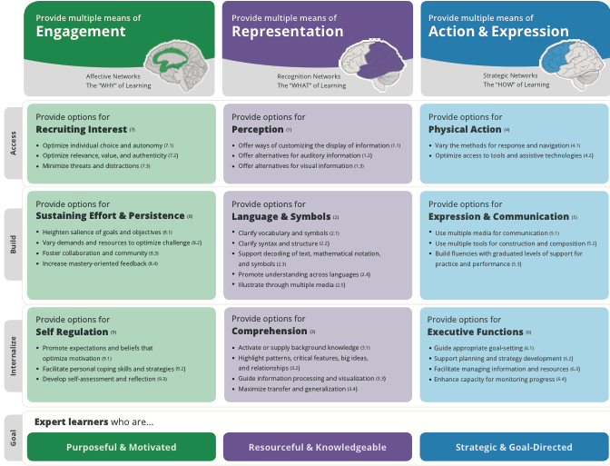
UDL Guidelines
Sources
Research in the learning sciences: cognitive science, cognitive neuroscience, neuropsychology, neuroscience.

Slide 9
UDL Guidelines --A11y
Provide Multiple Means of Engagement
Affective Network –The “why” of learning
Recruiting Interest
Optimize individual choice and autonomy
Optimize relevance, value, and authenticity
Minimize threats and distractions
Sustaining Effort & Persistence
Heighten salience of goals and objectives
Vary demands and resources to optimize challenge
Foster collaboration and community
Increase mastery-oriented feedback
Self-Regulation
Promote expectations and beliefs that optimize motivation
Facilitate personal coping skills and strategies
Develop self-assessment and reflection
Provide multiple means of Representation
Recognition Networks- The "WHAT" of learning
Perception
Offer ways of customizing the display of information
Offer alternatives for auditory information
Offer alternatives for visual information
Language & Symbols
Clarify vocabulary and symbols
Clarify syntax and structure
Support decoding of text, mathematical notation, and symbols
Promote understanding across languages
Illustrate through multiple media
Comprehension
Activate or supply background knowledge
Highlight patterns, critical features, big ideas, and relationships
Guide information processing and visualization
Maximize transfer and generalization
Provide Multiple Means of Action & Expression
Strategic Networks --The "HOW" of learning
Physical Action
Vary the methods for response and navigation
Optimize access to tools and assistive technologies
Expression & Communication
Use multiple media for communication
Use multiple tools for construction and composition
Build fluencies with graduated levels of support for practice and performance
Executive Functions
Guide appropriate goal-setting
Support planning and strategy development
Facilitate managing information and resources
Enhance capacity for monitoring progress

Slide 10
Expert Learning

Slide 11
Expert Learner Characteristics --A11y
Engagement Network
Purposeful and Motivated learners:
Are eager for new learning and are motivated by the mastery of learning itself
Are goal-directed in their learning
Know how to set challenging learning goals for themselves
Know how to sustain the effort and resilience that reaching those goals will require
Monitor and regulate emotional reactions that would be impediments or distractions to successful learning
Representation Network
Resourceful and Knowledgeable learners:
Consider prior knowledge when learning (Make connections to prior learning experiences)
Activate that prior knowledge to identify, organize, prioritize and assimilate new information
Recognize the tools and resources that would help find structure and remember new information
Know how to transform new information into meaningful and usable knowledge
Action & Expression Network
Strategic and Goal-Directed learners:
Formulate plans for learning
Devise effective strategies and tactics to optimize learning
Organize resources and tools to facilitate learning
Monitor their progress
Recognize their strengths and weaknesses as learners
Abandon plans and strategies that are ineffective

Slide 12
Questions & Discussion

Slide 13
Upcoming GLR Learning Tuesdays Webinars:
Crucible of Practice Salon Opportunity Culture: Positive Impacts for Educators and Students
Tuesday February 14, 12:30-2:00 pm ET/9:30-11:00 am PT
LEARNING LOSS RECOVERY CHALLENGE
Co-sponsored by New America Creating Environments and Conditions for Thriving Kindergartners February 14, 3:00 – 4:30 pm ET /12:00-1:30 pm PT
FUNDER TO FUNDER
Remake Learning: Philanthropic Opportunities for Enhancing Local Learning Landscapes
Tuesday February 21, 12:30-2pm ET/9:30-11:00 am PT
LEARNING LOSS RECOVERY CHALLENGE Preventing Burnout and #Resignation: Investing in Teacher Coaching and Support
Tuesday February 28, 2023, 3:00 – 4:30 pm ET/12:00-1:30 pm PT
Join us!
gradelevelreading.net @readingby3rd #GLReading #LearningTuesdays #GLRKeepers
gradelevelreading.net / @readingby3rd / #GLReading
Notes:
Sierra

