Slide 1
Preventing Burnout and #Resignation: Investing in Teacher Coaching and Support
February 28, 2023
gradelevelreading.net @readingby3rd #GLReading #LearningTuesdays

Slide 2
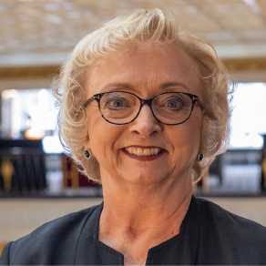
Moderator
Carey Wright, Ed.D.
Former State Superintendent of Education
Mississippi Department of Education
gradelevelreading.net @readingby3rd #GLReading #LearningTuesdays

Slide 3
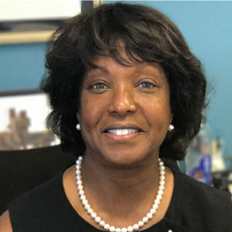
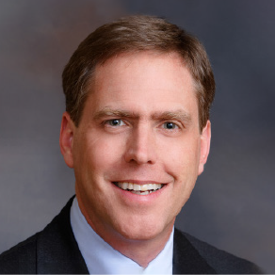
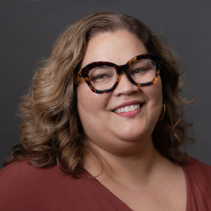
Presenters
Atyani Howard Chief Program Officer
New Teacher Center
Peggy Brookins. President and CEO
National Board for Professional Teaching Standards
Bryan Hassel. Co-President
Public Impact - Opportunity Culture
gradelevelreading.net @readingby3rd #GLReading #LearningTuesdays

Slide 4
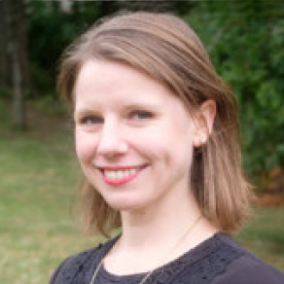
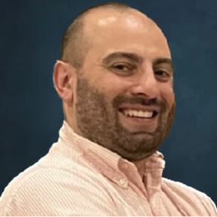
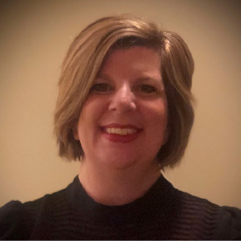
Presenter Commentators
Sarah Johnson Chief Executive Officer
Teaching Lab
Bishay M. Faris, SPHR Program Manager, Teacher-Leader Pathway
Charlotte-Mecklenburg Schools, North Carolina
Bonnie Short Director of the Alabama Reading Initiative
Alabama State Department of Education
gradelevelreading.net @readingby3rd #GLReading #LearningTuesdays

Slide 5
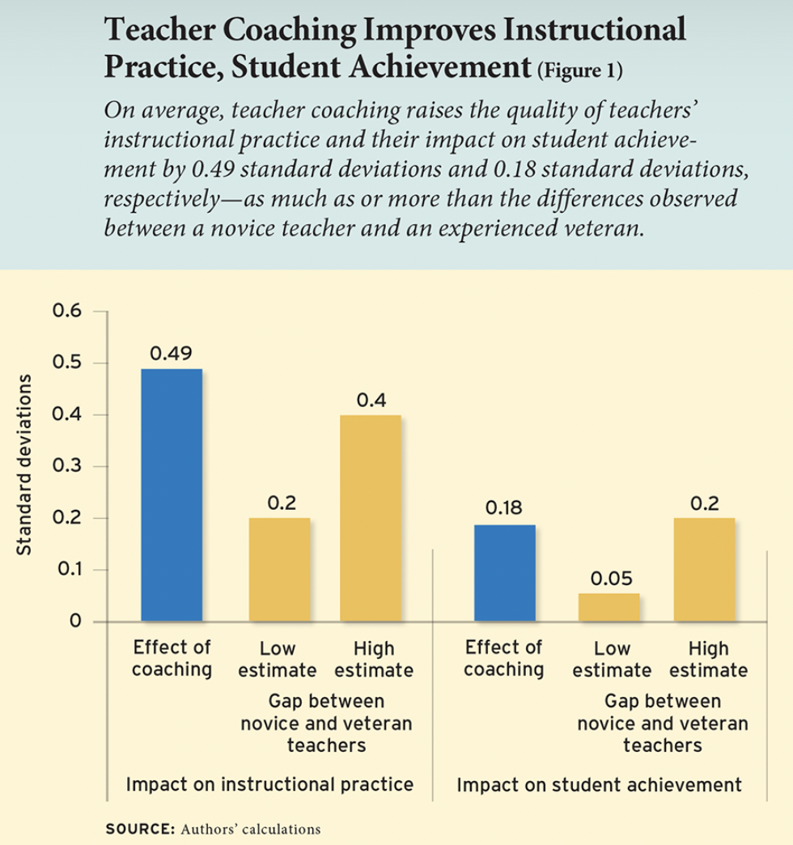
Research behind coaching employed by Teaching Lab.
Teaching Lab’s coaching approach includes the following evidence-based design features:
Embedded within a larger professional learning strategy that includes both “paired coaching and group trainings” (Kraft 2016)
Uses “an observation and feedback cycle in an ongoing instructional...situation” (Joyce 1981)
Provides “sustained professional dialogue...focused on developing specific skills to enhance their teaching” (Lofthouse, 2010)
Leveraging content knowledge building “prior to engaging directly with a coach.” (Kraft 2016)

Slide 6
Advanced Teaching Roles in Charlotte-Mecklenburg Schools
The Teacher Leader Pathway

Slide 7
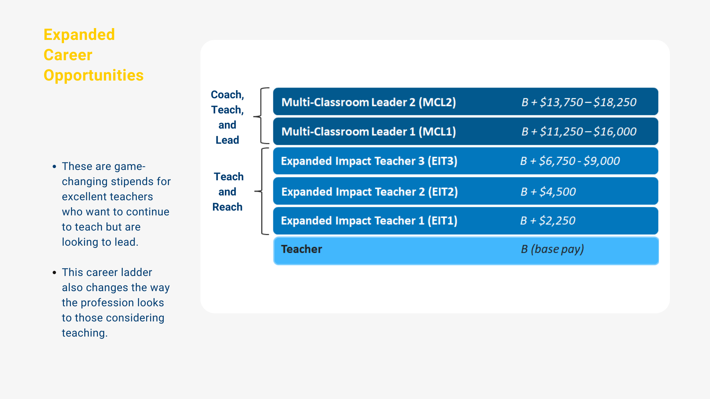

Slide 8
Coaching and Support

Slide 9
ESSR & NCDPI Grant Funds
In CMS, ESSER and NCDPI grants support:
District Staff Salaries
Professional Development
Networking and informal support opportunities
These funds do not support:
Advanced Teaching Role Pay Differentials
Advanced Teaching Role Job 1 Positions
Sustainability is ensured by creating all ATR positions through existing school budgets such as:
Regularly allotted ADM
Title 1 funds
Restart Funds

Slide 10
TLP Academy
TLP Academy recently moved from an in person, three day training to a predominantly asynchronous format. Three preparation modules are housed in Canvas with a five month completion window.
Modules focus on key components of program implementation
Schools may not hire TLP roles until Module 1 is completed
On-site support following Module 1
Schools may not hire TLP roles in the following school year if all three modules have not been completed by the due date
Notes:
Modules focus on role responsibility, school structure, candidate sourcing, recommendations, communication, position exchanges and funding, PD opportunities, and the talent pool process
Schools may not hire TLP roles until Module 1 is completed
Schools may not hire TLP roles in the following school year if all three modules have not been completed by the due date

Slide 14
Additional Information
The Teacher-Leader Pathway Department Website includes
General program information
Explanations of all roles and responsibilities
Talent Pool steps, rubrics, application materials, and tips
All participating school sites
Grant information
http://bit.ly/CMSTEACHERLEADER

Slide 15
Questions & Discussion

Slide 16
Upcoming GLR Learning Tuesdays Webinars:
DIGITAL ACCESS FOR ALL
Digital Access and Telehealth: What's Working, What Are the Challenges and What Are the Opportunities? Tuesday, March 7, 12:30−2:00 p.m. ET/19:30 - 11:00 a.m. PT
Co-sponsored by the Patterson Foundation
LEARNING LOSS RECOVERY CHALLENGE
Promoting High Quality Math and Science Learning in Kindergarten Tuesday, March 7, 3−4:30 p.m. ET/12−1:30 p.m. PT
Co-sponsored by New America
CRUCIBLE OF PRACTICE SALON
Bringing Digital Equity to All Students in Grinnell, Iowa Tuesday, March 14, 12:30−2:00 p.m. ET/19:30 - 11:00 a.m. PT
Join us!
gradelevelreading.net @readingby3rd #GLReading #LearningTuesdays #GLRKeepers
gradelevelreading.net / @readingby3rd / #GLReading
Notes:
Sierra

Slide 17
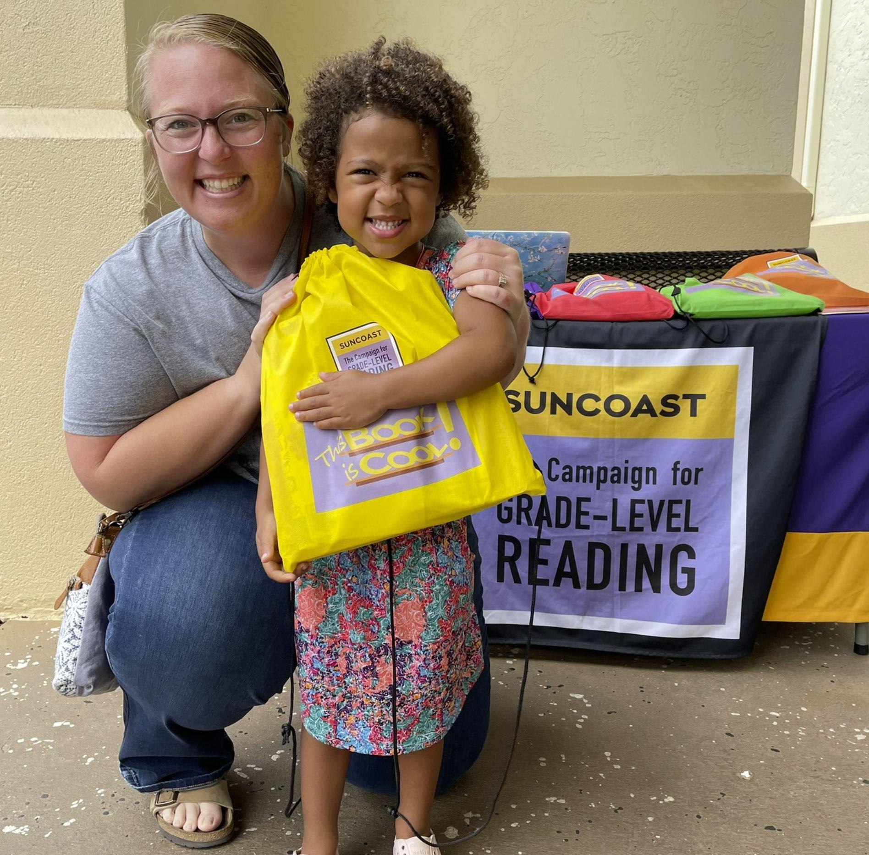
This invitation to share is open to everyone!
We are gathering information about a few strategies related to learning loss recovery.
The form is quick and easy to complete. This information will help all of us understand what’s happening in our communities and support engagement that will unfold later this year.
Here is the link to complete your responses:
WHAT'S WORKING QUESTION FORM
Notes:
Here is the link to add to chat: https://forms.gle/4xqNE8rXrDKRzfjh9

